Slide 1
Real World Test-Driven Development with Pester
June Blender
Technology Evangelist
SAPIEN Technologies, Inc.
Windows PowerShell MVP
juneb@sapien.com
@juneb_get_help

Slide 2
Tested Versions
The information and code used in this presentation were tested with the following system attributes.
Microsoft Windows 10 Pro 10.0.10586 (x64), Windows Server 2012 R2 (x64), Microsoft Window 10 Home Insider Preview 10.0.14279
Windows PowerShell 5.0.10586.122, 5.0.14279.1000
Pester 3.4.0
Contact: June Blender, @juneb_get_help, juneb@sapien.com

Slide 3
Why Test?
Efficiency
Reliability
Continuity
Trust
Professionalism
Excellence
Notes:
Invest in test in the short run, bec. easier to prevent error than to clean up after one.

Slide 4

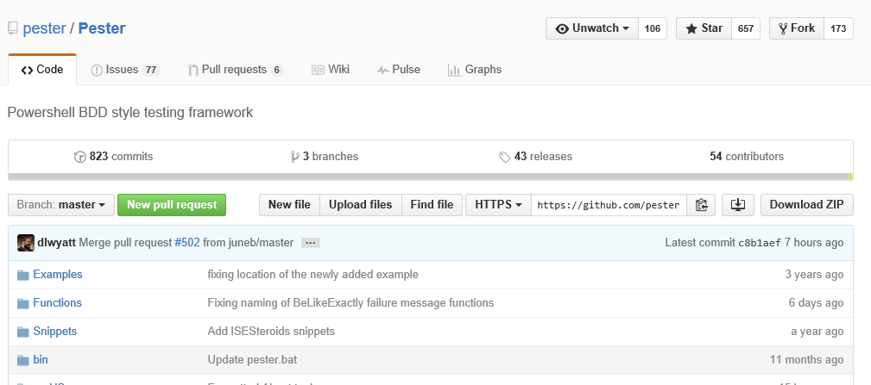
Pester: PowerShell Tester A test framework for Windows PowerShell
Notes:
Compares actual-expected; could have been ad hoc, non-standard; instead studied academic discipline code testing, .Tests. files

Slide 5
Test-Driven Development (TDD - since 1999)
Write the test before the code. Code to the test. Code is simpler. Always tested. Developer is not afraid to change the code.
While ($True) {
Write a test.
Run all tests. New test fails.
Write some code (as little as possible).
Run tests (pass).
Refactor code.
}
Notes:
Innovative. Behavior-driven development : Management process for TDD. Focuses on UX in testing.

Slide 6
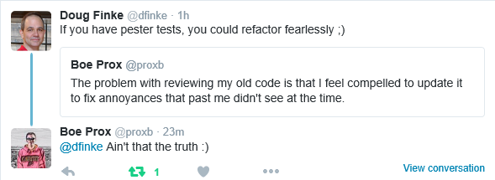
Test-Driven Development (TDD - since 1999)
Write the test before the code. Code to the test. Code is simpler. Always tested. Developer is not afraid to change the code.
Notes:
Innovative. Behavior-driven development : Management process for TDD. Focuses on UX in testing.

Slide 7
Behavior-Driven Development (BDD)
Tests describe the behavior ("black box"), not the implementation ("white box")
Tests should be independent of state.
Tests should be independent of each other.
Simple, small steps.
Tests should cover all features, including combinations of features.
Test code is *like* production code. It should be readable and maintainable.

Slide 8
Which tests do I write?
How do I write useful tests?
What elements of my code do I test?
How do I avoid writing tests that are too easy?
How many tests is enough?

Slide 9
"Help-Driven Development (HDD)"
Start with a help file
Help examples are your contract with the user.
Examples are the test spec. Test is the code spec.
Write a test for every example.
Supports behavior-driven development (BDD).
Results in better tests and better help

Slide 10
ManageProfiles Module Manages Windows PowerShell profiles
Disables profiles -- so they don't affect my code/test
Re-enables profiles -- when I want them
Gets enabled and disabled profiles

Slide 11
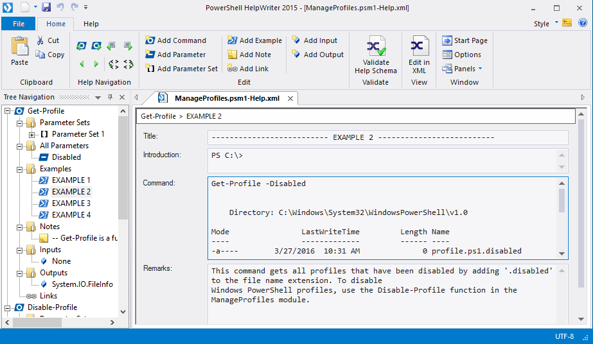
Start with a help file White box testing
Examples are a test spec. Test is a code spec.

Slide 12
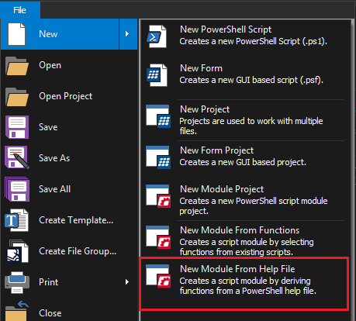
Create module from a help file

Slide 13
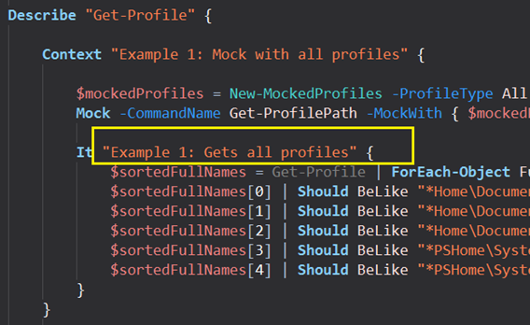
Create tests for each example
Demo

Slide 14
How to Pester
Describe
Context
It
Should
Be
Mock
InModuleScope
TestDrive: and $TestDrive
Invoke-Pester
Learn the syntax and forget it.
Use Pester's domain-specific language.

Slide 15
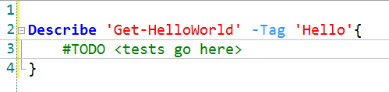
Describe Naming container
Describe { }
Container (required) : Encloses tests
Can call its TestName or Tag in Invoke-Pester
Creates a scope for mocking and TestDrive:
Name is required and arbitrary

Slide 16
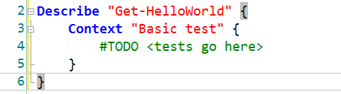
Context Mocking container
Describe { Context {...} }
Optional container within Describe
Encloses tests
Smallest container that creates a mocking scope
Name is required and arbitrary

Slide 17
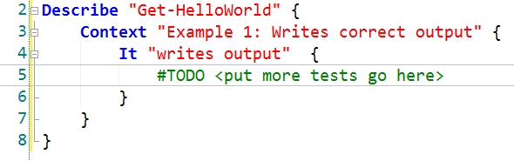
It Test container
Describe { Context { It {...} }}
Encloses tests
Does not create a mock scope
Name is required and arbitrary

Slide 18
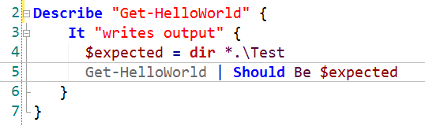
Should Compares actual to expected
Describe { Context { It { <>| Should ... }}}
Compares actual to expected ("assertion")
Uses comparison operator specified by Be (Not Be)
Pipe script/function output to Should
Always followed by 'Be' / 'Not Be'

Slide 19
Be / NotBe comparison operators (private functions)
Describe { Context { It { <>| Should Be }}}
Be
BeExactly
BeLike
BeLikeExactly
BeGreaterThan
BeLessThan
BeNullOrEmpty
BeOfType
Contain (file)
ContainExactly (file)
Exist
Match
MatchExactly
Throw (script block input)
Not Be
Not BeExactly
Not BeLike
Not BeLikeExactly
Not BeGreaterThan
Not BeLessThan
Not BeNullOrEmpty
Not BeOfType
Not Contain (file)
Not ContainExactly (file)
Not Exist
Not Match
Not MatchExactly
Not Throw (script block input)
List might change over time. Stay alert.
Use snippets.
Notes:
Like takes wildcards; Exactly is case-sensitive. Contains works only with file content.

Slide 20
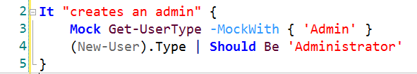
Mock Lets you write independent tests Test with varying input Replaces the output of a cmdlet with specified value
Mock. Because "it works on my machine" isn't a valid bug resolution.
Mocked cmdlet doesn't run. Returns result you specify.
Don't mock the cmdlet you're testing.
Mock the cmdlet that provides input.
In unit test, mock all calls to other functions in the script/module
Notes:
Replaces input to the cmdlet with the input that you specify.

Slide 21
Mock does not scope to It blocks It scopes to Describe and Context
It "the mock in this block" {
$testPaths = Get-TestPath
Mock Get-ChildItem -MockWith { $testPaths }
Test-MyCode | Should Be "A"
}
It "affects this block, too" {
Test-MyCode | Should Be "B"
}

Slide 22
TestDrive: PowerShell Drive (PSDrive) Tests independent of file system
PSDrive: Temporary drive in an $env:Temp location
$TestDrive variable: Actual full path
Created anew for each Describe block
Scoped:
Child scope: r/w parent
Child files discarded
Child changes saved

Slide 23
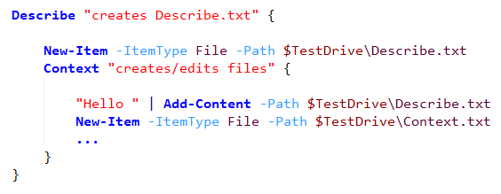
TestDrive: PowerShell Drive (PSDrive) Scoping

Slide 24
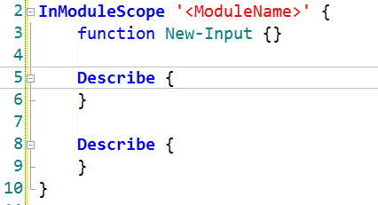
InModuleScope Creates test elements in module scope
InModuleScope { Describe { Context { It { <>| Should Be <> }}} }
Container
Name required, but *not* arbitrary
All module resources are available to the test (not just exported)

Slide 25
Invoke-Pester function
Runs Pester tests
Runs all *.Tests.ps1 files in directory (recursively)
-Script <string>/<hashtable> (alias = Path)
-TestName <string[]> (Describe) (supports wildcards)
-Tag <string[]> (Describe) (no wildcards)
-PassThru
-CodeCoverage <string>/<hashtable>
-OutputFile <string> (.xml)
-OutputFormat (LegacyNUnitXml,NUnitXml)
-Quiet

Slide 26
Invoke-Pester -CodeCoverage Verifies that every line code is exercised in test
-CodeCoverage requires path to file to analyze (not the test file)
CodeCoverage path must be fully-qualified. Default is current path, not -Script path. No recurse. Wildcards are permitted.
Verifies that code is run, not tested.
Notes:
0.3.0.1

Slide 27
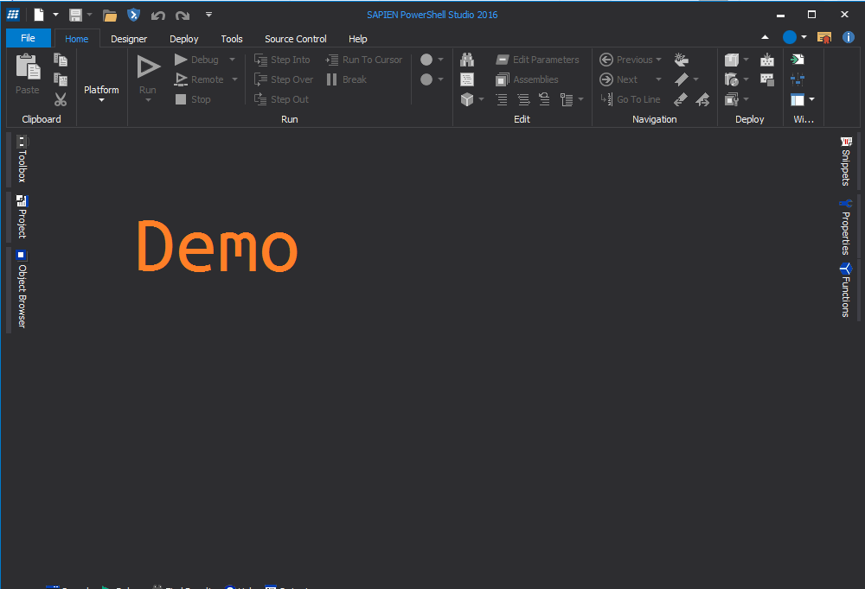

Slide 28
Testing Modules Every shared module should have a .Tests. file
InModuleScope
You can mock any function (exported or internal)
Can't handle multiple versions
Write separate tests for nested modules

Slide 29
Conclusions
It took a long time, but so did my first script
Evaluate process for the long-term, not the short term
Too easy to assume Pester bug (most were my mistakes)
Most valuable for regression testing
OutputType is valuable for tests and mocking
Errors should be explained in the help file
Every module should have at least one Tests file

Slide 30
Test-Driven Development Glossary
Unit test: Tests individual segments of code independently
Integration test: Tests code segments together
Acceptance test: Tests production code.
Regression test: Rerun tests to detect breaks from code changes
White Box: Tests implementation
Black Box: Tests user experience
Mock: Replace a command call with specified output
Fixture: Defines repeatable test environment.
Scaffolding: Creating the structure of code without the details

Slide 31
Resources
Test-Driven Development by Example, by Kent Beck, Addison-Wesley 2003
Pester on GitHub: https://github.com/pester/Pester
Getting Started with Pester by Jakub Jares
What is Pester? by Dave Wyatt (5-part series)
Automated Testing in PowerShell (video) by Dave Wyatt
Slides\code : https://github.com/juneb/PesterTDD

Slide 32

Thanks for the help!
Dave Wyatt
@PSPester & GitHub\Pester Team
Jakub Jares
Mike Robbins

Slide 33
Real World Test-Driven Development with Pester
June Blender
Technology Evangelist
SAPIEN Technologies, Inc.
Windows PowerShell MVP
@juneb_get_help
juneb@sapien.com

